Slide 1
DATABASE MANAGEMENT
SYSTEMS II

Slide 2
THE DATABASE ENVIRONMENT
Introduction to Databases:
      ANSI-SPARC Architecture
      Data independence
      Data models
      Relational database concepts
      Introduction to DDL & DML

Slide 3
Objectives of Three –Level Architecture
A database is a shared resource , therefore different users might require different views of the same database. To satify this, the architecture of most commercial DBMS’s today is based on ANSI-SPAC architecture in which;
NB: ANSI-SPARC: American National Standards Institute – Standards Planning and Requirements Committee.
Introduction to Database Languages
1.<number>

Slide 4
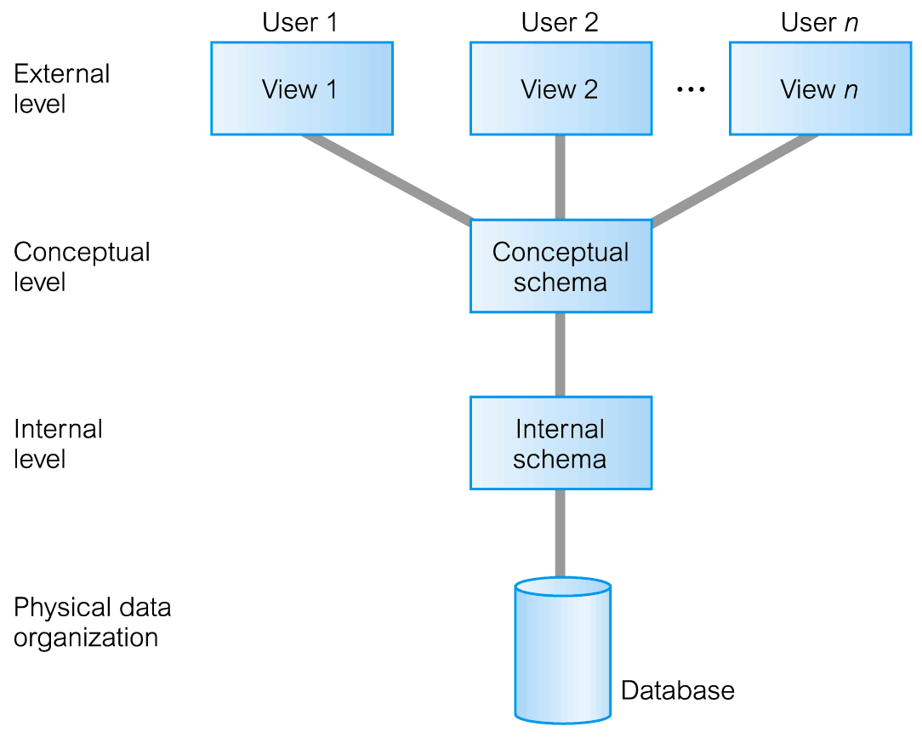
ANSI-SPARC 3-Level Architecture
ANSI-SPARC Architecture

Slide 5
THE ANSI –SPARC ARCHITECURE
The ANSI-SPARC Architecture is the most common standard on which database systems were developed. Databases follow the generalized architecture. It is made up of three levels.
The external level: This is at the interface level. It represents the database as viewed by the user. defines user views.
The conceptual Level: This describes what data is stored in the database and the relationship among the data. It also describes the constraints on the data. It defines how information is arranged within the database and how the data is inter-related.
Introdes
1.<number>

Slide 6
THE ANSI –SPARC ARCHITECURE
The Internal Level:
The way the DBMS and the operating system perceive the data .
The internal level involves how the database is physically represented on the computer system. It describes how the data is actually stored in the database and on the computer hardware.
Introduction to Database Languages
1.<number>

Slide 7
The 3-level ANSI-SPARC Architecture
The objective of Three-level architecture is to:
Separate each users view of the database: from the way the database is physically represented.
The following are reasons why this separation is desirable;
  All users should be able to access same data. But have a different customized view of the data. A user’s view is immune to changes made in other views.
  DBA should be able to change conceptual structure of database without affecting other user’s views.
ANSI-SPARC Architecture

Slide 8
Objectives of Three-Level Architecture.
DBA should be able to change database storage structures without affecting the users views.
The structure of the database should be unaffected by changes to the physical aspects of the storage . For example a changeover to a new disk
Introduction to Database Languages
1.<number>

Slide 9
ANSI-SPARC Three-Level Architecture
External Level
This is at the interface level.
It represents the database as viewed by the user. defines user view of the database.
Describes that part of database that is relevant to a particular user.
Conceptual Level
  Community view of the database. It is the logical structure of the entire DB.
  Describes what data is stored in database and relationships among the data.
ANSI-SPARC Architecture

Slide 10
Conceptual Level
The conceptual level represents :
All entities , their attributes, and their relationships.
Constraints on the data.
Data from any view is derived from the conceptual level.
Introduction to Database Languages
1.<number>

Slide 11
ANSI-SPARC Three-Level Architecture
Internal Level
  The way the DBMS and the OS perceive data;
  Involves how the database is physically represented on the computer system. It describes how the data is actually stored in the database and on the computer hardware
  Covers data structures and file organizations used to store data on the storage devices.
  Data structure is a particular way of storing and organizing data in a computer so that it can be used efficiently.
ANSI-SPARC Architecture

Slide 12
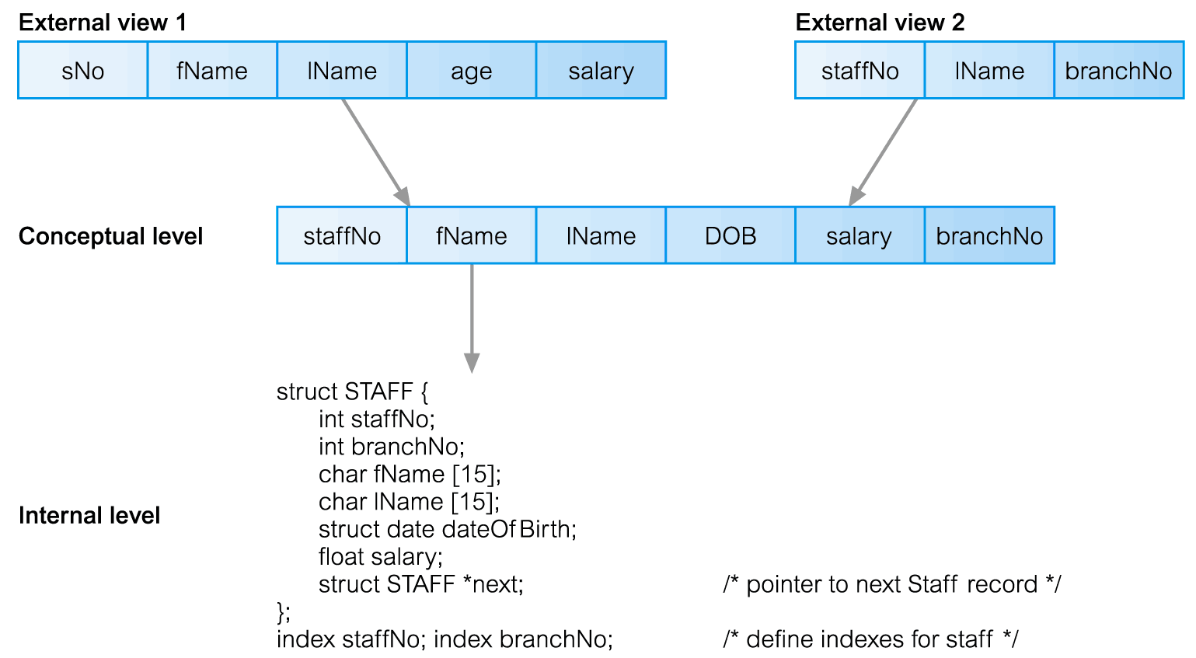
Differences between Three Levels of ANSI-SPARC Architecture
ANSI-SPARC Architecture

Slide 13
Data Independence
Data independence is a form of database management that keeps data separated from all programs that make use of the data.
Refers : The immunity/resistance of user applications to make changes in the definition and organization of data.
Each higher level of the data architecture is immune to changes of the next level of the architecture.
As a cornerstone for the idea of a DBMS or database management system, data independence ensures that the data cannot be redefined or reorganized by any of the programs that make use of the data.
Introduction to Database Languages
1.<number>

Slide 14
Data Independence 2 types
Logical Data Independence
  The ability to change the logical schema without changing the external schema .
  Refers to immunity of external schemas to changes in conceptual schema.
  Conceptual schema changes (e.g. addition/removal of entities, attributes or relationships). Should not require changes to external schema or rewrites of application programs.
  But users for whom the changes have been made, need to be aware of them- other users should not.
ANSI-SPARC Architecture

Slide 15
Data Independence
Physical Data Independence
  Refers to immunity of conceptual schema to changes in the internal schema.
  Example . A change to the internal schema such as using different file organization or storage structures, storage devices, or indexing strategy should be possible without having to change the conceptual or external schemas.
  Users only notice the change in the performance ( because deterioration in the performance is the major cause for internal schema changes)
ANSI-SPARC Architecture

Slide 16
Data Model
A data model is a collection of concepts that can be used to describe the structure of a database.
Data models are often used as an aid to communication between the business people defining the requirements for a computer system and the technical people defining the design in response to those requirements. They are used to show the data needed and created by business processes.
Introduction to Database Languages
1.<number>

Slide 17
Data Model
Provides basic notations and concepts that will allow database designers and end-users to clearly and accurately communicate their understanding of the organisational data.
Introduction to Database Languages
1.<number>

Slide 18
Data Model
Data Model comprises:
  A structural part (a set of rules according to
  which databases can be constructed)
  A manipulative part (defining the types of operations that are allowed on the data).
  Possibly a set of integrity rules which ensure that data is accurate.
Purpose of Data Model.
  To represent the data in an understandable way.
Introduction to Database Languages
1.<number>

Slide 19
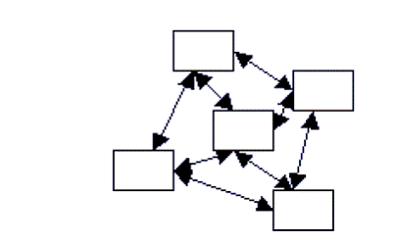
Types of Data Models.
Network Model: Represents data as nodes and relationships are implied by linking up the nodes by edges.
Introduction to Database Languages
1.<number>

Slide 20
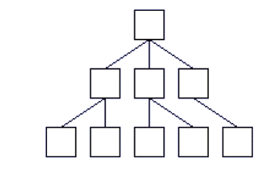
Hierarchical Model: A tree-graph representation is used (records/segments as nodes and sets as edges.)
    A node is allowed to have only one parent
Represents data and nodes in a hierarchical manner.
Introduction to Database Languages
1.<number>

Slide 21
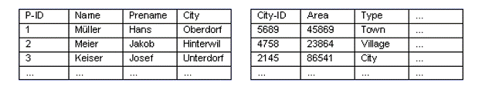
Data Models
Relational Model: Uses relations/tables to organize data. A row /tuple represents an instance of data and relationships are represented by foreign keys.
    Data and relationships are represented as tables, each having uniquely identified columns
The Object Oriented Model: Uses the object oriented paradigm of encapsulation, inheritance . Aclass represents data and an object represents the instance.
Introduction to Database Languages
1.<number>

Slide 22
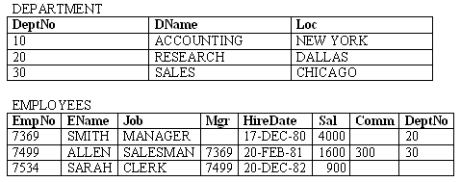
Example of a Relational DB
A company needs to store information on departments and employees.
Each table contains data that describes exactly one entity - a thing of significance about which information needs to be known.
Relational Database Concepts
1.<number>

Slide 23
Relational Database Concepts
Relation – a table composed of rows and columns
Attribute – a column of a relation.
Tuple – a row of a relation.
Cell – an intersection of a row and a column of a relation.
Domain – a set of allowable values for one or more attributes.
Null – a value that is unknown or not applicable in a given cell. representation of "missing information and inapplicable information".
Relational Database Concepts
1.<number>

Slide 24
Relational Database Concepts Cont’d
Degree – The number of attributes in a relation is degree of that relation.
Cardinality – number of tuples for a given relation.
Relation schema – a named collection of attributes and any data constraints.
  Constraints: Enforce rules at table level. Eg Not Null, Primary key ,Foreign Key, Check
Representation of a department relation schema
  DEPARTMENT (DeptNo, DName, Loc)
  A department no value must never be repeated. Such a constraint is what is referred to as a primary key constraint.
Relational Database Concepts
1.<number>

Slide 25
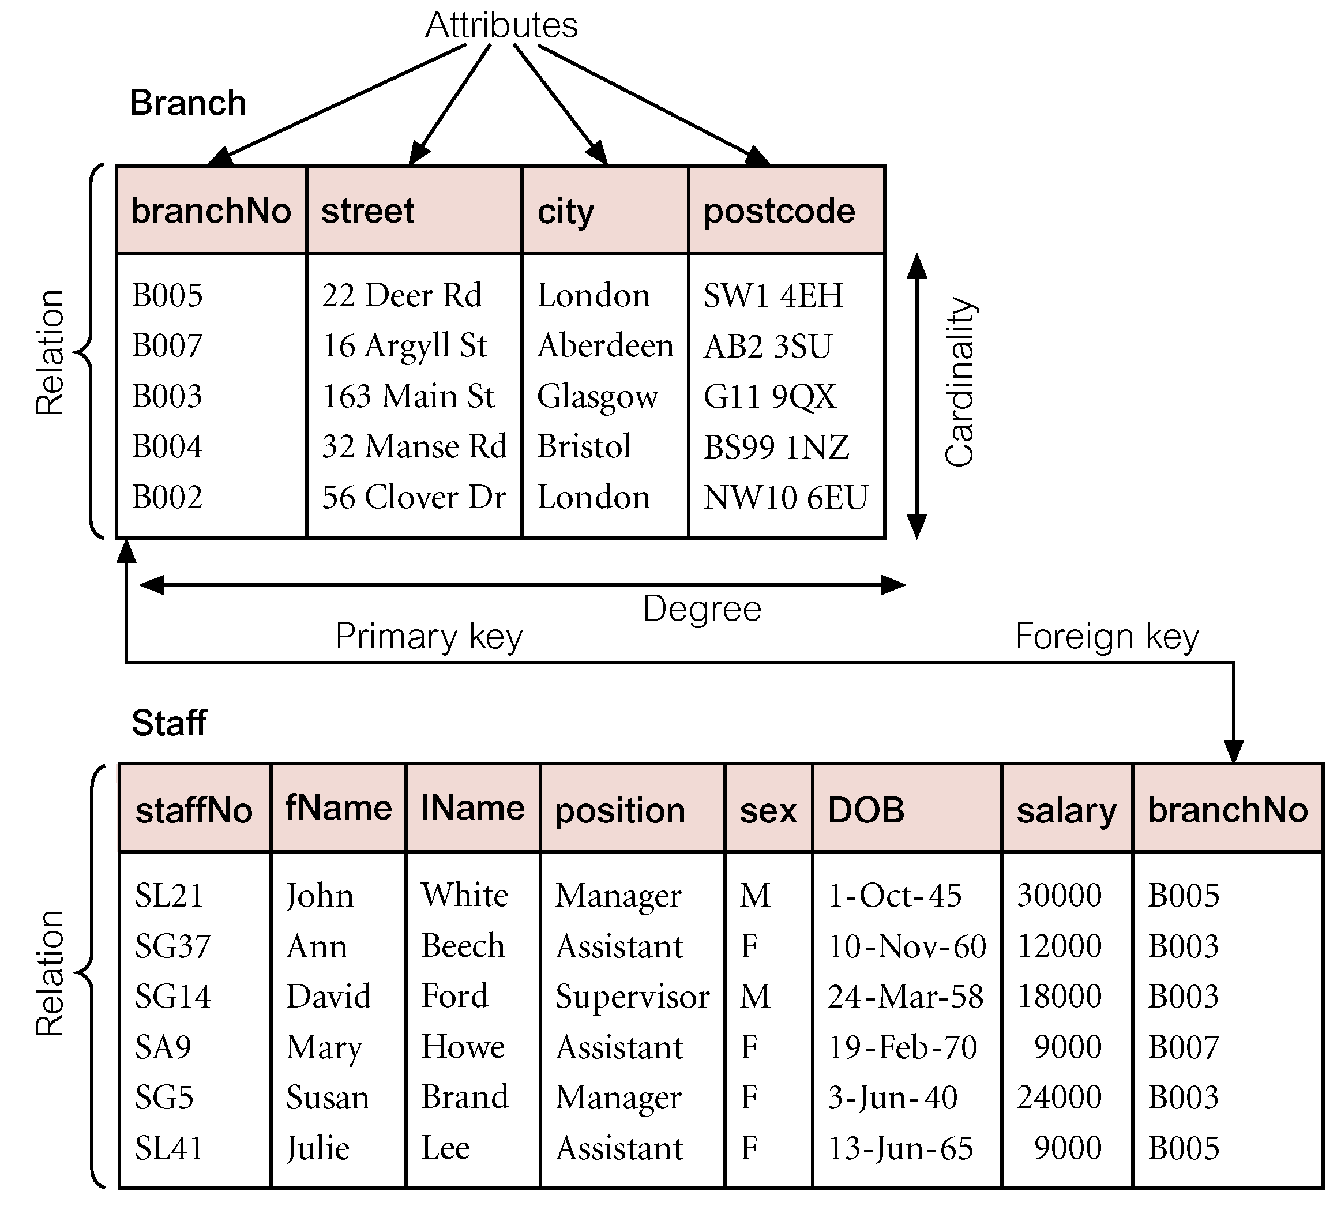
Instances of Branch and Staff (part) Relations
Relational Database Concepts
1.<number>

Slide 26
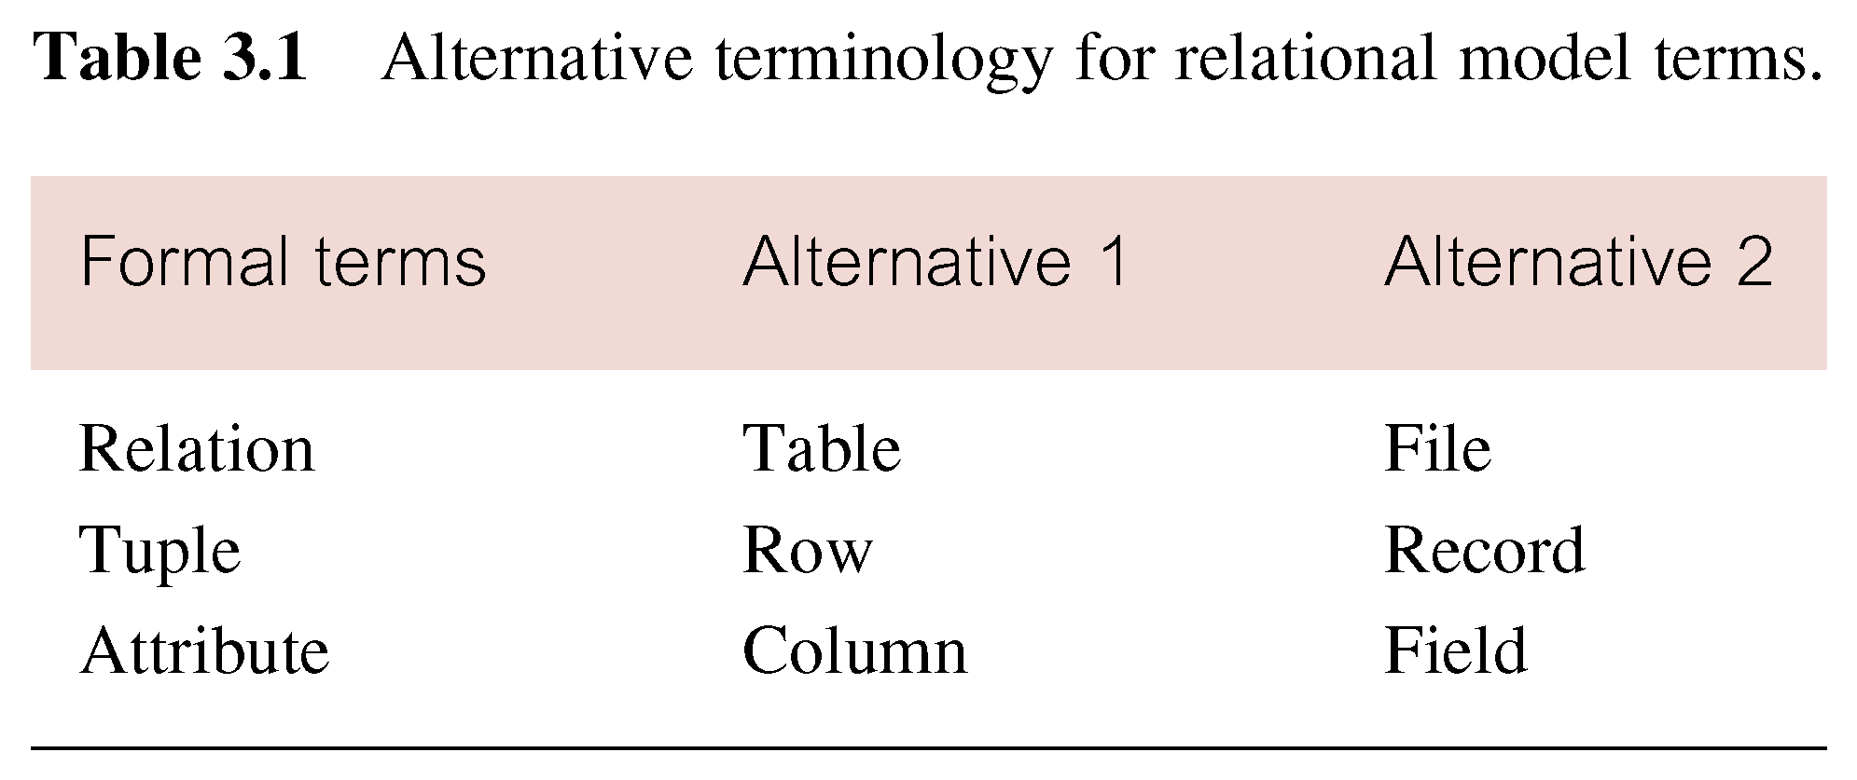
Alternative Terminology for Relational Model
Relational Database Concepts
1.<number>

Slide 27
Relational Database Concepts Cont’d
Relational database – A database whose structure is made up of numerous separate but linked tables.
Representation of a relational database schema for a company that stores information on departments and employees.
  DEPARTMENT (DeptNo, DName, Loc)
  EMPLOYEES (EmpNo, EName, Job, Mgr, HireDate, Sal, Comm, DeptNo)
Relational Database Concepts
1.<number>

Slide 28
Relational Database Concepts Cont’d
Primary key – An attribute that is selected to uniquely identifies each record within a relation.
A primary key value must be unique and cannot be null.
Foreign key – An attribute within one relation that matches another attribute of another or same relation.
A foreign key value must match the primary/unique key value of some tuple in its parent relation or the foreign key value must be wholly null.
Relational Database Concepts
1.<number>

Slide 29
Relational Integrity
Null
  Represents value for an attribute that is currently unknown or not applicable for tuple
  Deals with incomplete or exceptional data.
  Represents the absence of a value and is not the same as zero or spaces, which are values.
Enterprise Constraints
  Additional rules specified by users or database administrators.
  Examples of enterprise constraints. ( domain, entity and referential integrity Constraints )
Relational Database Concepts
1.<number>

Slide 30
Database Languages
Database Languages are known as data Sublanguages. And consist of two parts : A DDL and DML
DBMSs have a facility for embedding the sublanguage in a high-level programming language e.g. C, C++, Java Or VB. The high-level language is then known as a host Language.
Introduction Database Languages
1.2.<number>

Slide 31
Database languages Cont’d
A data sublanguage consists of two parts:
  Data definition Language (DDL)
  This is a language that allows the DBA or user to describe and name the entities, attributes and relationships required for the application, together with any associated integrity and security constraints.
  Used to specify the database schema.
  ( Database Schema : is a set / collection of meta data that describes the relations in a database).
Introduction Database Languages
1.2.<number>

Slide 32
Data Definition Language (DDL)
(Begg & Connolly, 2002)
DDL is not only used to specify new database schemas but also to modify exiting ones. A database schema is a logical grouping of objects that belong to a user.
All created objects / structures (such as tables, views) are stored in a database schema.
Data Definition Languages
1.2.<number>

Slide 33
DDL cont’d
Relation DB schema objects are created and maintained by using SQL DDL statements (such as CREATE, ALTER, DROP).
The result of compiling DDL statements is a set of tables stored in special files collectively called the system catalog.
The system catalog may also be referred to as a data dictionary.
Data Definition Languages
1.2.<number>

Slide 34
DDL Cont’d
The data dictionary integrates the meta-data; definitive information about the structure is recorded in a data dictionary.
  For example: definitions about the records, data items and other objects of interest to users or required by the DBMS.
Example of DDL SQL statement:
  CREATE, ALTER, DROP, RENAME, TRUNCATE
Data Definition Languages
1.2.<number>

Slide 35
Data Manipulation Language (DML)
This is a language that provides a set of operations to support the basic data manipulation operations on the data held in the database.
Some of the operations include:
  Insertion of new data into the database
  Modification of data stored in the database
  Retrieval of data contained in the database (Query language).
  Deletion of data from the database.
Data Manupulation lanaguages
1.2.<number>

Slide 36
DML Cont’d
Non-Procedural DML
allows user to state what data is needed rather than how it is to be retrieved.
The end-users use a high-level query language to specify their requests to DBMS to retrieve data. Usually a single statement is given to the DBMS to retrieve or update multiple records.
Data Manupulation lanaguages
1.2.<number>

Slide 37
Procedural DML
  This a language that allows the user to tell the system what data is needed and exactly how to retrieve the data; allows user to tell system exactly how to manipulate data.
  This type of DML typically retrieves individual records from the database and processes each separately. In this language, the looping, branching etc. statements are used to retrieve and process each record from a set of records.
Introduction to Database Languages
1.<number>

Slide 38
DML Cont’d
Examples of DML SQL statements;
  INSERT
  UPDATE
  DELETE
  MERGE
  A LTER
Data Manupulation lanaguages
1.2.<number>

Slide 39
Multi-User DBMS Architecures
Teleprocessing
File Server
Client -Server
Introduction to Database Languages
1.<number>

Slide 40
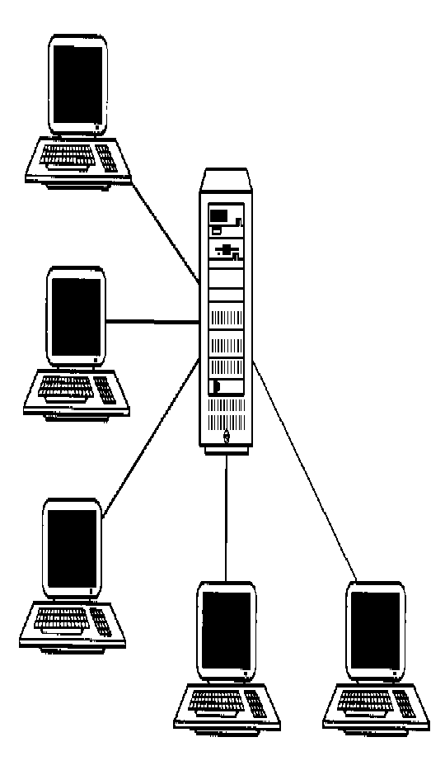
Teleprocessing
Traditional Architecture
Single mainframe with a number of terminals attached .
One computer with a
single CPU and a number of terminals. All processing is done within the boundaries of physical computer.
.
Introduction to Database Languages
1.<number>

Slide 41
File-Server
File Server is connected to several workstations across the network.
Database resides on file-server.
However the DBMS and applications run on each workstation.
The file-server acts simply as a shared hard disk drive.
Disadvantage,
copy of DBMS on each work station.

Slide 42
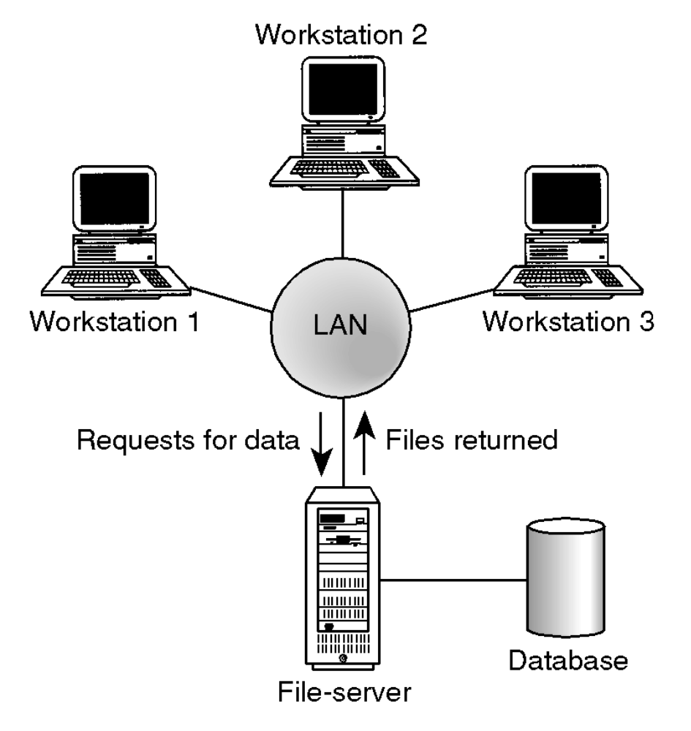
File Server Architecture
Introduction to Database Languages
1.<number>

Slide 43
Client-server
Server holds the database and the DBMS.
Clients manages users interface and runs applications.
The client is primarily responsible for the presentation of data to the user, and the server is primarily responsible for supplying data services to the client
Advantages include:
Wider access to existing databases
Increased performance.
Possible reduction in hardware costs.
Introduction to Database Languages
1.<number>

Slide 44
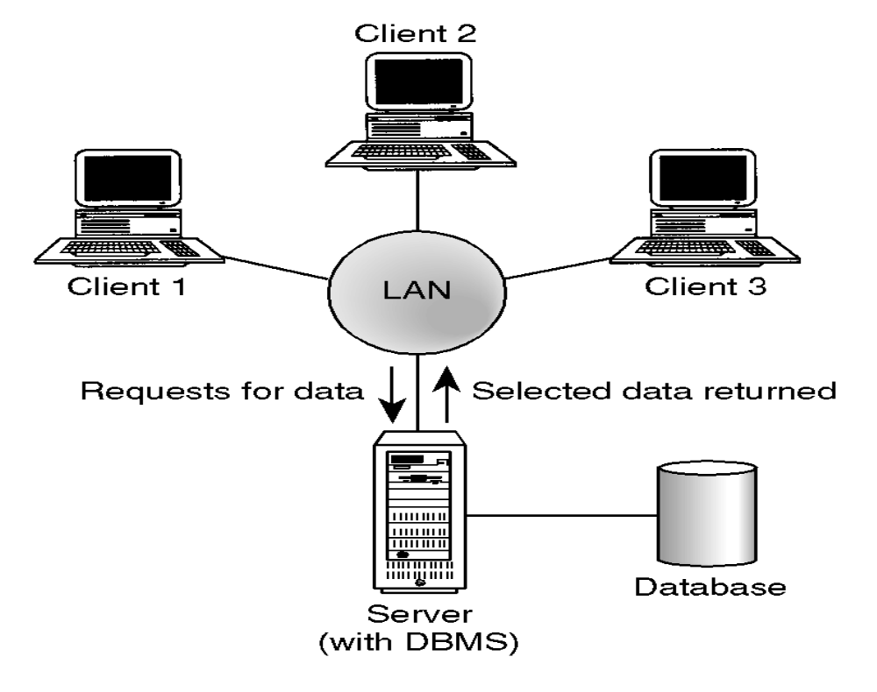
Client-Server Architecture
Introduction to Database Languages
1.<number>

Slide 45
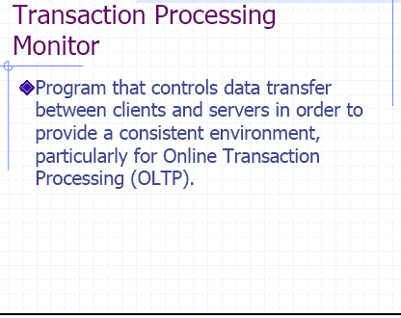
Introduction to Database Languages
1.<number>

Slide 46
TPM
A TPM is a middleware component that provides access to the services of a number of resource managers and provides a uniform interface for programmers who are developing transactional software .
Introduction to Database Languages
1.<number>

Slide 47
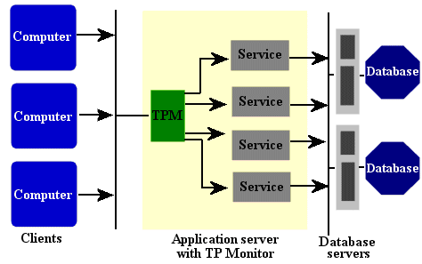
Transaction Processing Monitors
Introduction to Database Languages
1.<number>

Slide 48
When not to use Databases
There are circumstances when databases are not appropriate to be used. These include
a)If the data involved is small and can easily be organized using traditional means.
b) If the application lifespan is small.
Introduction to Database Languages
1.<number>

